Slide 1
Lecture: Graph Basics

Slide 2
Overview
Graph representation Ch 22.1

Slide 3
What is a Graph? (Recap)
Graph Definition:
  Graphs have vertices (nodes) connected by edges
  Graph G is a pair (V, E), where
    V: Finite set of vertices (n=∣V∣)
    E: Finite set of edges (m=∣E∣)
In graph,
  node = Vertex,
  nodes = vertices
  connection between 2 nodes = edge

Slide 4
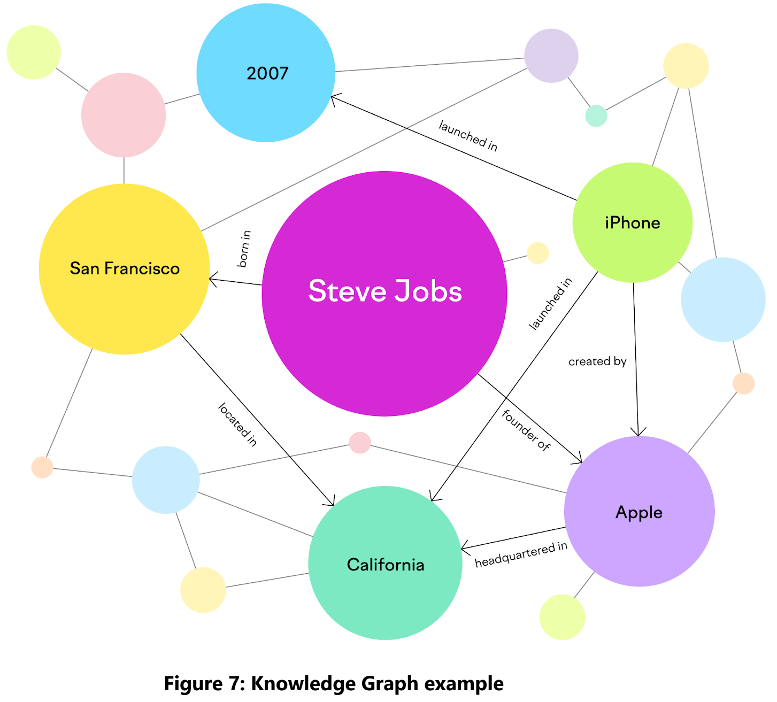
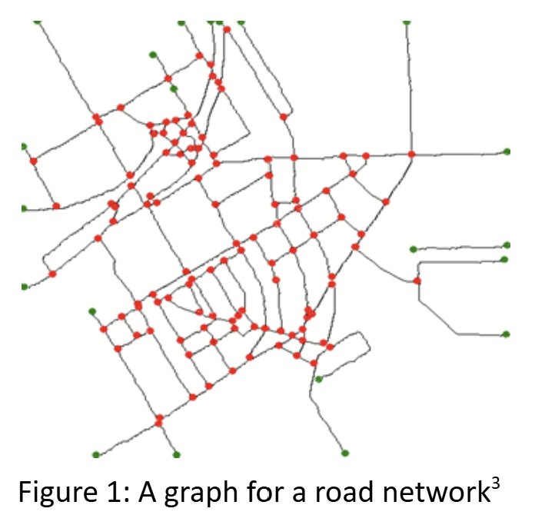
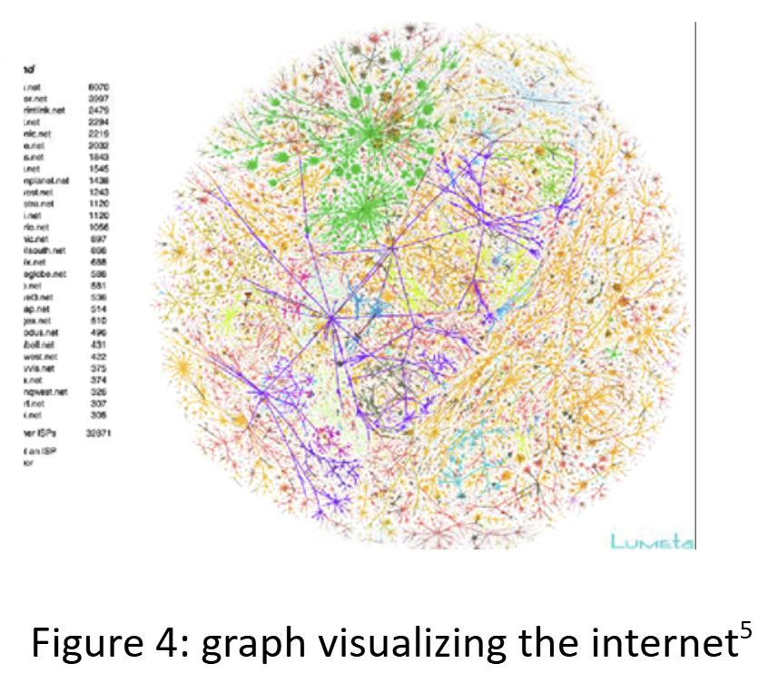
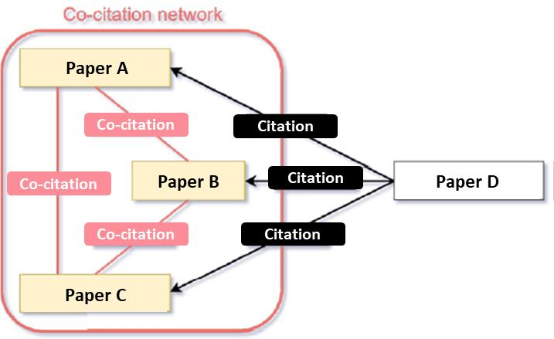
Examples of graphs
Transportation Networks (e.g., Road maps: Pathao, Uber; Flight routes: Emirates, US-Bangla Airlines)
Communication Networks (e.g., the internet, telecommunication systems)
Information Networks (e.g., citation graphs, knowledge graphs, protein structure)
Image source3: https://www.researchgate.net/figure/An-example-of-road-network-extraction-and-graph-representation_fig12_279263325
Image source5: https://www.researchgate.net/figure/2-A-graph-visualisation-of-the-topology-of-network-connections-of-the-core-of-the_fig2_239550496
Image source7: https://www.semrush.com/blog/knowledge-graph/

Slide 5
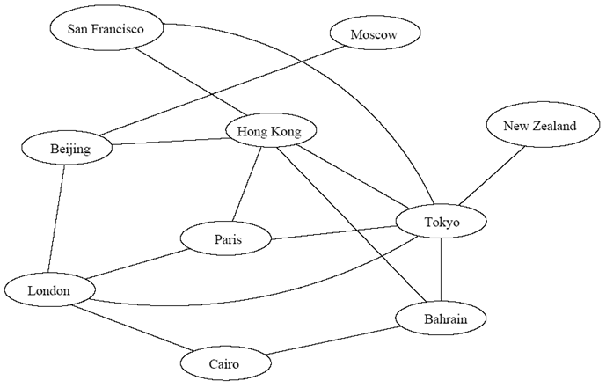
Transportation Networks : flight routes example
Each vertex represents a city
Each edge represents a direct flight between two cities
A query on direct flights = check whether an edge exists between two vertices
A query on how to get to a location = check whether a path exists from city A to city B
If costs are associated with edges (i.e., weighted graphs),
we can Ask: “What is the cheapest path from A to B?”

Slide 6
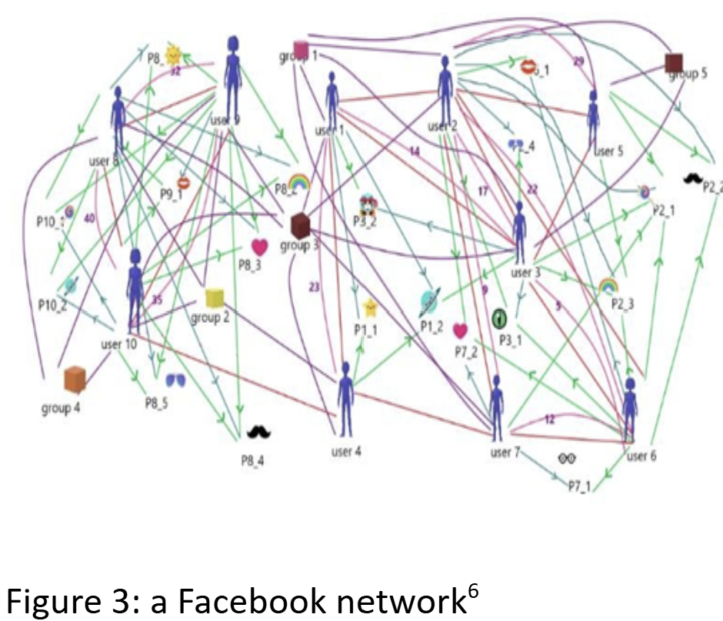
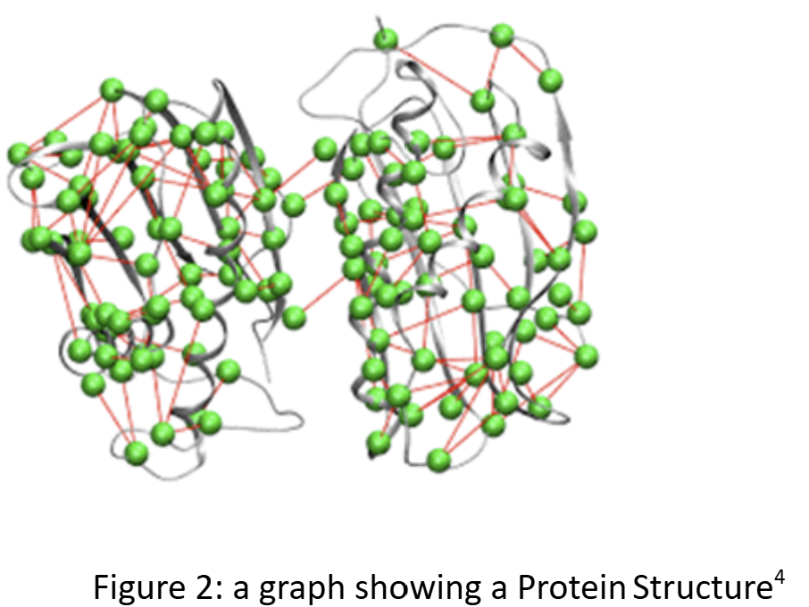
Examples of graphs
Social Networks (e.g., Facebook, LinkedIn)
Dependency Networks (e.g., task scheduling, software dependencies)
Image source6: https://www.researchgate.net/publication/340347681_A_Study_on_Graph_Theory_Properties_of_On-line_Social_Networks
Image source4: https://benthamopen.com/contents/supplementary-material/TOBIOIJ-5-53_SD1.pdf

Slide 7
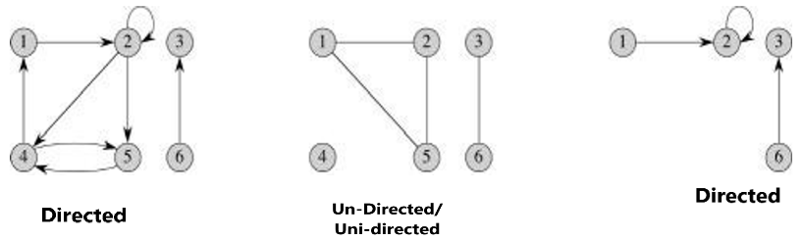
Directed vs undirected Graph (Recap)
Graph Types:
Directed:
  E contains ordered pairs
  Edges have direction (one-way streets)
Undirected: (Bi-directional)
  E contains unordered pairs
  Edges have no direction (two-way streets)
Vertex Adjacency:
If (u, v ) ∈ E ,
then vertices u and v are adjacent.
^{In graph,}
^{node = Vertex,}
^{nodes = vertices}
connection between 2 nodes = edge
¹Cormen, Leiserson, Rivest, Stein. Introduction to Algorithms, 3rd edition, MIT Press, 2009

Slide 8
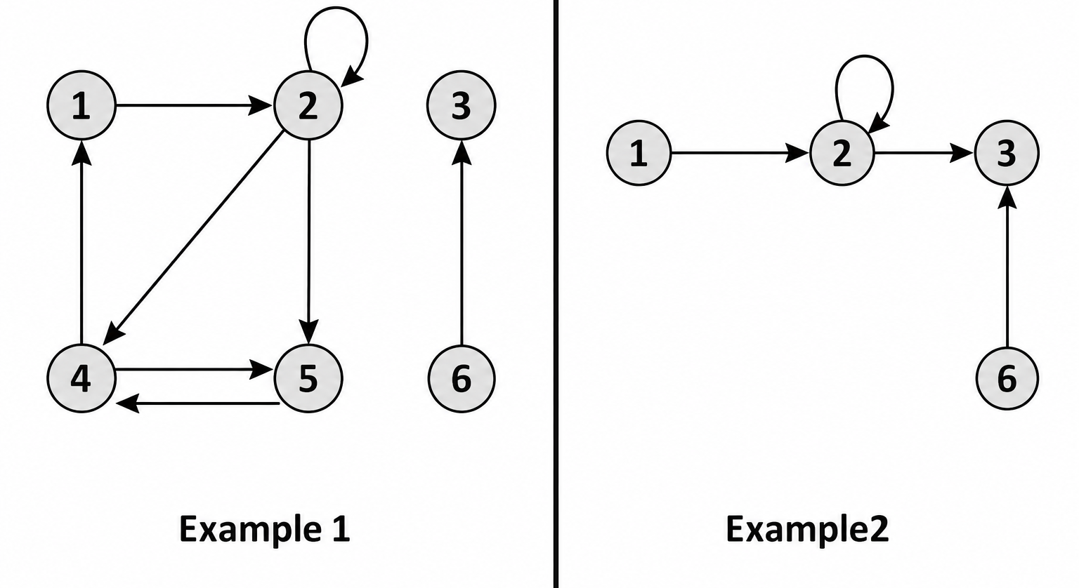
Self-loop in A Graph
A self-loop in a graph is an edge that starts and ends at the same vertex.
It is an edge of the form (v, v).
In both examples, vertex 2 has a self-loop, as the edge starts and ends at the same vertex, 2.
¹Cormen, Leiserson, Rivest, Stein. Introduction to Algorithms, 3rd edition, MIT Press, 2009

Slide 9
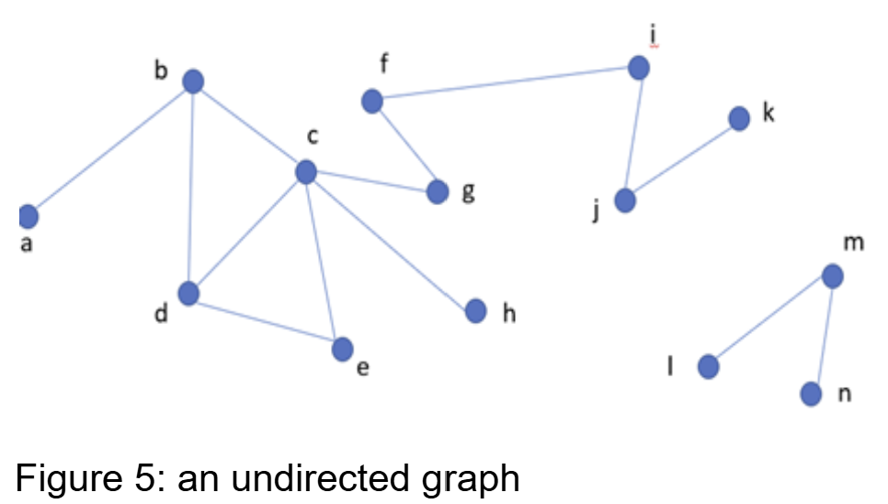
Vertex Degrees
Here, v is a node/vertex
For undirected graph:
  Degree (deg⁡(v)): Number of edges connected to v
What is the degree of d here?

Slide 10
Vertex Degrees
Here, v is a node/vertex
For undirected graph:
  Degree (deg⁡(v)): Number of edges connected to v
Degree of d is 3.
Because d is connected to b, c, e by 3 edges

Slide 11
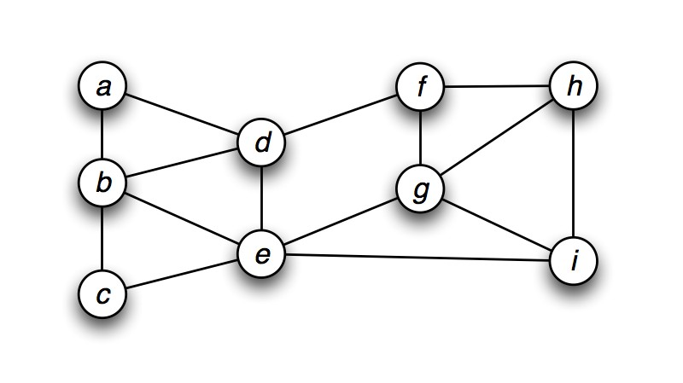
Vertex Degrees
For undirected graph:
  Degree (deg⁡(v)): Number of edges connected to v
Example (Undirected graph)
Vertex | deg
a | 2
b | 4
c | 2
d | 4
e | 5

Slide 12
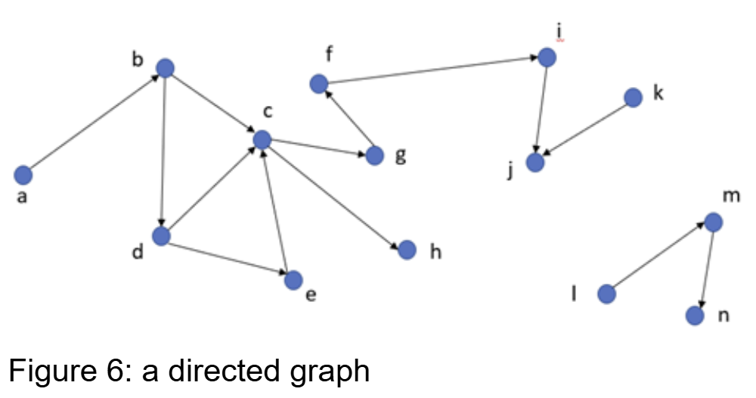
Vertex Degrees
Vertex Degrees:, here v is a node/vertex
For directed graph:
  In-degree (indeg(v)): Number of incoming edges to v (Number of edges ending at the vertex)
  Out-degree (outdeg(v)): Number of outgoing edges from v (Number of edges originating from the vertex)
Directed Edge Representation: Edge (a,b): Outgoing from a, incoming to b.
What is in-degree and out-degree of d?

Slide 13
Vertex Degrees
Vertex Degrees:, here v is a node/vertex
For directed graph:
  In-degree (indeg(v)): Number of incoming edges to v (Number of edges ending at the vertex)
  Out-degree (outdeg(v)): Number of outgoing edges from v (Number of edges originating from the vertex)
Directed Edge Representation: Edge (a,b): Outgoing from a, incoming to b.
In-degree of vertex d is 1. (incoming from b)
Out-degree of vertex d is 2. (out-going to c, e)

Slide 14
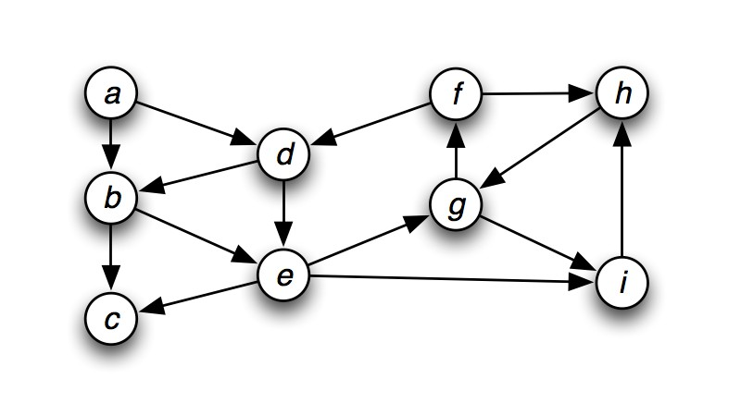
Vertex Degrees
For directed graph:
  In-degree (indeg(v)): Number of incoming edges to v (Number of edges ending at the vertex)
  Out-degree (outdeg(v)): Number of outgoing edges from v (Number of edges originating from the vertex)
Example (Directed graph)
Vertex | in out
a | 0 2
b | 2 2
c | 2 0
d | 2 2
e | 2 3

Slide 15
Path in a Graph
Path: A sequence of edges connecting two vertices.
Length of Path: Number of edges in the path.
Distance: Shortest path length (number of edges) between two vertices.
Path from a to d: (3 possible paths)
(a,b), (b, d), length=2
(a,b),(b,c),(c,d), length=3
(a,b),(b,c),(c,e),(e,d), length=4
Distance from a to d: 2 [(a,b), (b, d)]

Slide 16
Path in a Graph
Path: A sequence of edges connecting two vertices.
Length of Path: Number of edges in the path.
Path from a to d: (Only 1 possible path)
(a,b), (b, d)

Slide 17
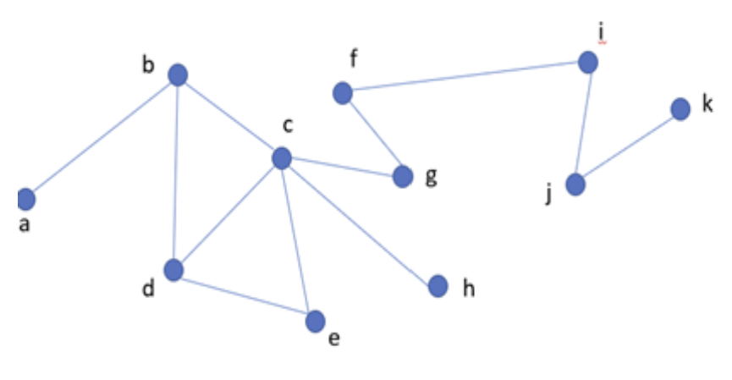
Connected Graph
The undirected graph G is connected,
if for every pair of vertices u, v there exists a path from u to v

Slide 18
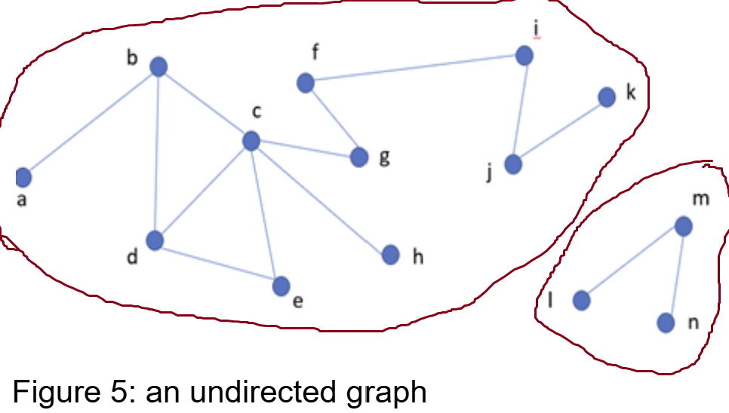
Disconnected Graph
Disconnected Graph: No path exists between certain vertices.
Vertices that are mutually reachable, they form a component.
If a graph is not connected, the vertices of the graph can be divided into
connected components.
Two vertices are in the same connected component
If and only if they are connected by a path.
Example (Figure 5): The graph has two components.

Slide 19
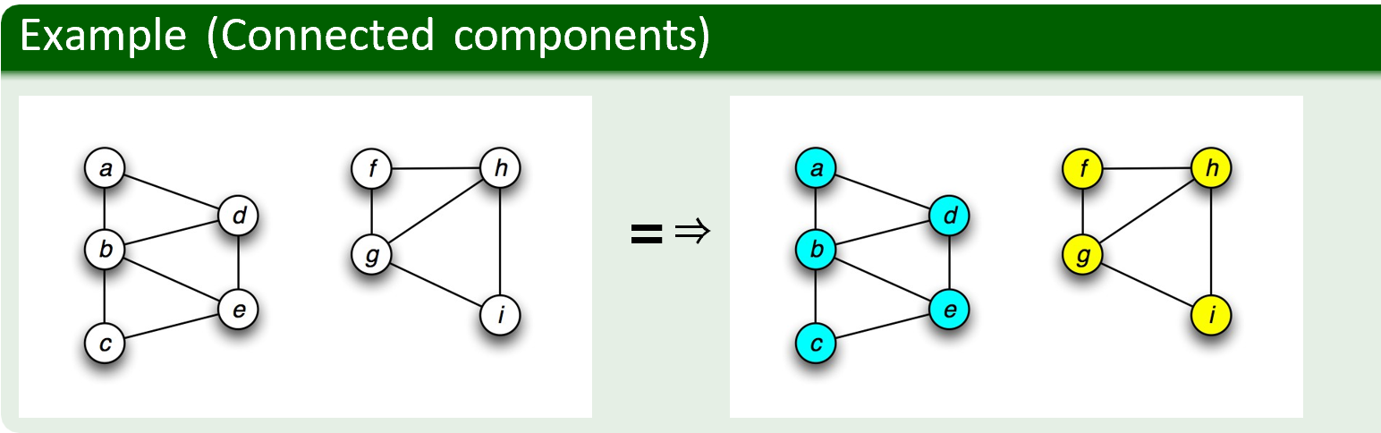
Disconnected Graph
Disconnected Graph: No path exists between certain vertices.
Vertices that are mutually reachable, they form a component.
If a graph is not connected, the vertices of the graph can be divided into connected components.
Two vertices are in the same connected component
If and only if they are connected by a path.
Example: The graph has two components.

Slide 20
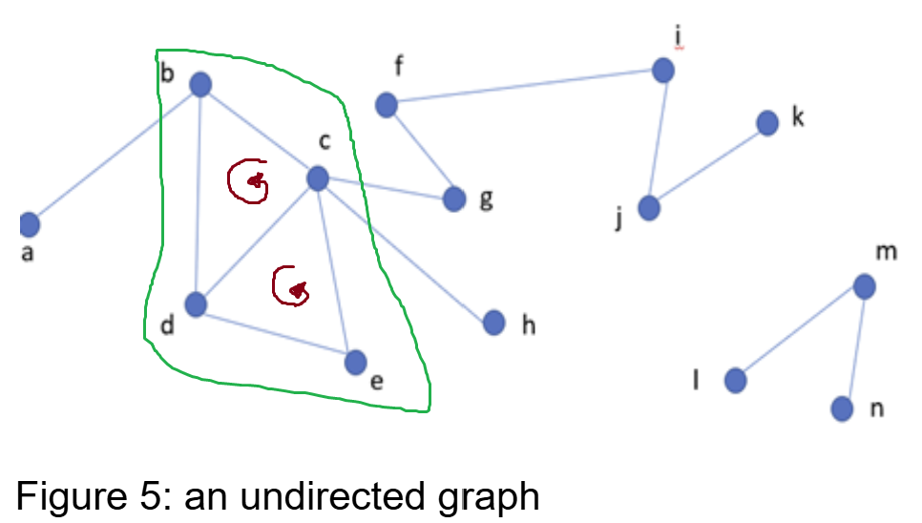
Cycle in a Graph
A sequence of edges that starts and ends at the same vertex.
  In a directed graph, the cycles are also directional.
There are no cycles, it’s called “Acyclic” graph
If there is at least one cycle, it’s called “cyclic” graph
Example (Figure 5): formed cycles are
  (b, d), (d, c), (b, c)
  (d, e), (e, c), (c, d)
  (b,d), (d,e), (e,c), (c,b)

Slide 21
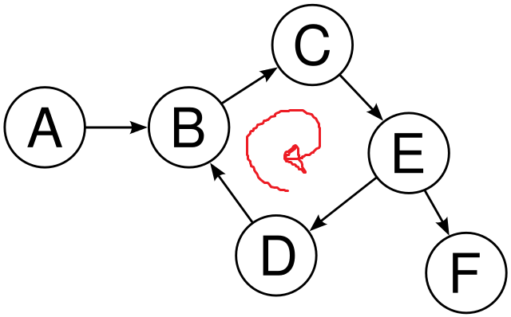
Cycle in a Graph
A sequence of edges that starts and ends at the same vertex.
In a directed graph, the cycles are also directional.
Example (Figure 6): There are no cycles, it’s called “Acyclic” graph
Example (Figure 8): (B, C), (C, E), (E, D), (D, B)
If there is at least one cycle, it’s called “cyclic” graph
Figure-8: directed graph

Slide 22
Weighted Graphs
Vertices and/or edges can have weights assigned.
  Vertex Weight: Represents the importance of the entity/object/concept
    (e.g., traffic capacity of a junction).
  Edge Weight: Represents the cost or strength of the relationship between vertices
    (e.g., distance between road junctions).
Graphs can be Weighted Directed or Weighted Undirected.
Example: Road Network Graph
Vertices/nodes: Road junctions.
Vertex Weights: Traffic capacity at each junction.
Edge Weights: Distance between junctions (length of roads).

Slide 23
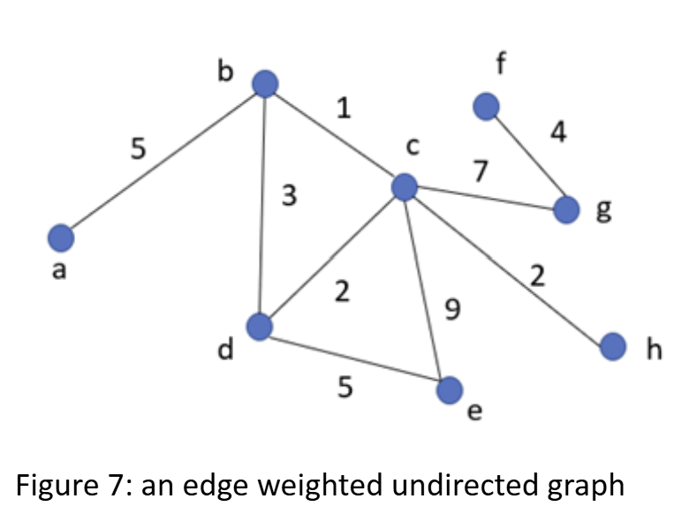
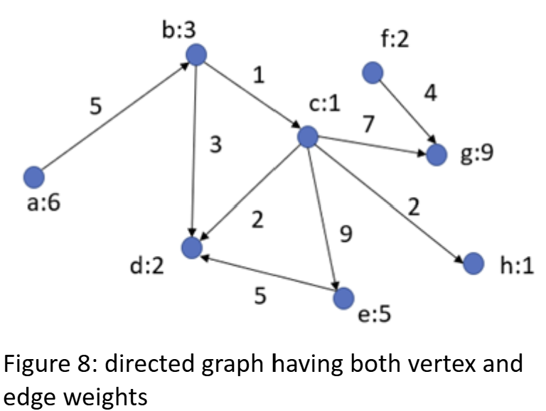
Weighted Graphs
Vertices and/or edges can have weights assigned.
  Vertex Weight: Represents the importance of the entity/object/concept (e.g., traffic capacity of a junction).
  Edge Weight: Represents the cost or strength of the relationship between vertices (e.g., distance between road junctions).
Graphs can be Weighted Directed or Weighted Undirected.

Slide 24
Default Graph Type
Unless specified, "graph" refers to
an undirected, unweighted graph

Slide 25
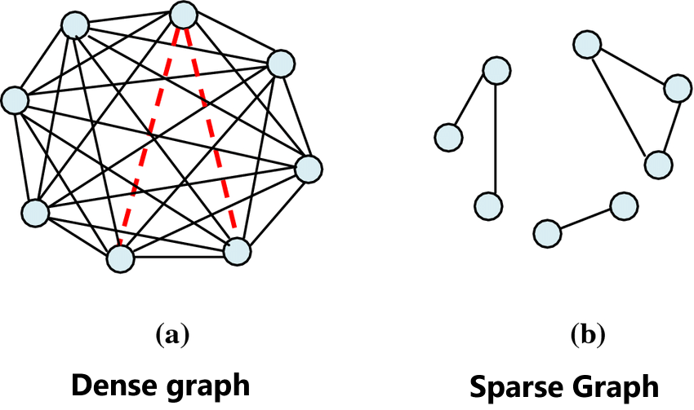
Sparse vs Dense Graph
Sparse Graph: Few edges relative to the number of vertices (nodes). If |E|≈ |V|
Dense Graph: Many edges relative to the number of vertices (nodes). If |E|≈ |V|²
Importance:
The distinction between sparse and dense graphs influences the
choice of data structure for graph representation.
image source: https://www.researchgate.net/publication/333950431_Multi-moth_flame_optimization_for_solving_the_link_prediction_problem_in_complex_networks

Slide 26
Graph representation
Graphs vs Trees: Unlike trees, graphs may lack a root node, making it impossible to traverse all vertices from a single starting point, especially in disconnected graphs.
Solution for Graph Representation:
In typical graph representations, all vertices and edges are explicitly provided to ensure the entire graph structure is accessible, regardless of connectivity.
Graph representation Ch 22.1

Slide 27
Graph representation
Graph Representations:
Adjacency Matrix (Use a 2D matrix to represent the graph)
Adjacency List (Use a 1D array of linked lists)
Incidence Matrix (Use a 2D matrix to represent the graph)
  (popular for electrical circuits) [Optional]
Graph representation Ch 22.1

Slide 28
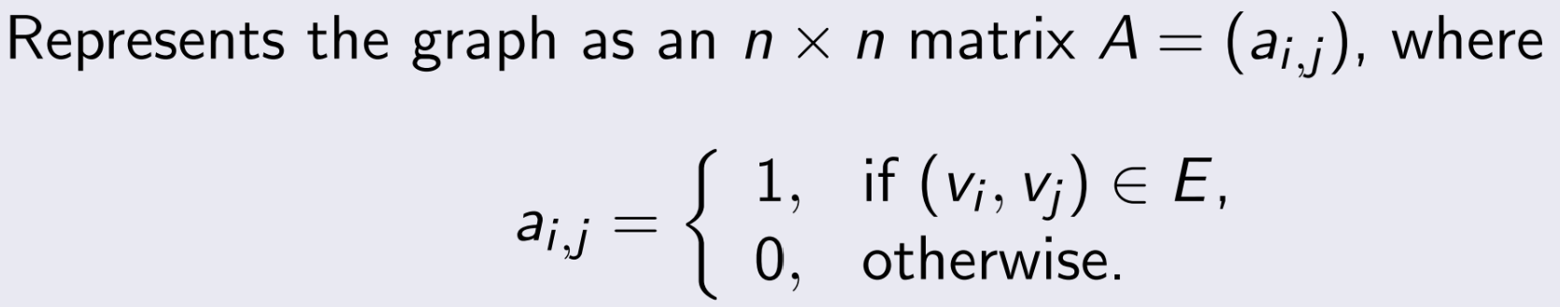
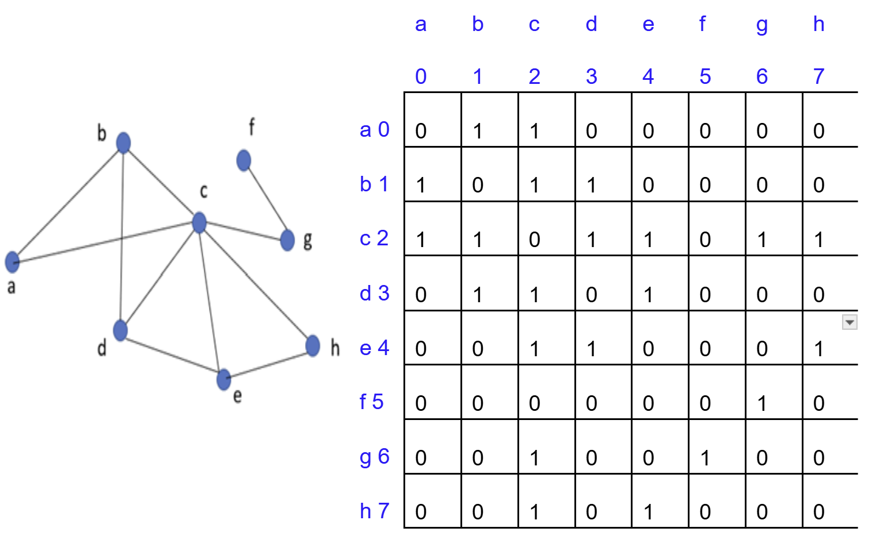
Adjacency Matrix Representation
Graph representation Ch 22.1

Slide 29
Adjacency Matrix Representation
Undirected Graphs: The matrix is symmetric (A[i][j]=A[j][i]).
For example, (2, 3) and (3, 2) have the same value
Directed Graphs: The matrix is not symmetric unless each edge (a,b) has a corresponding (b,a).
Graph representation Ch 22.1

Slide 30
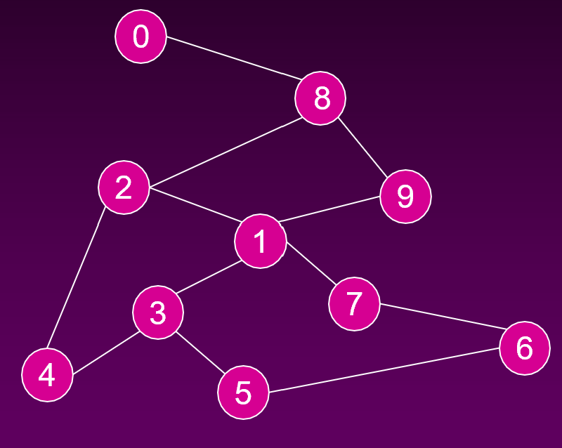
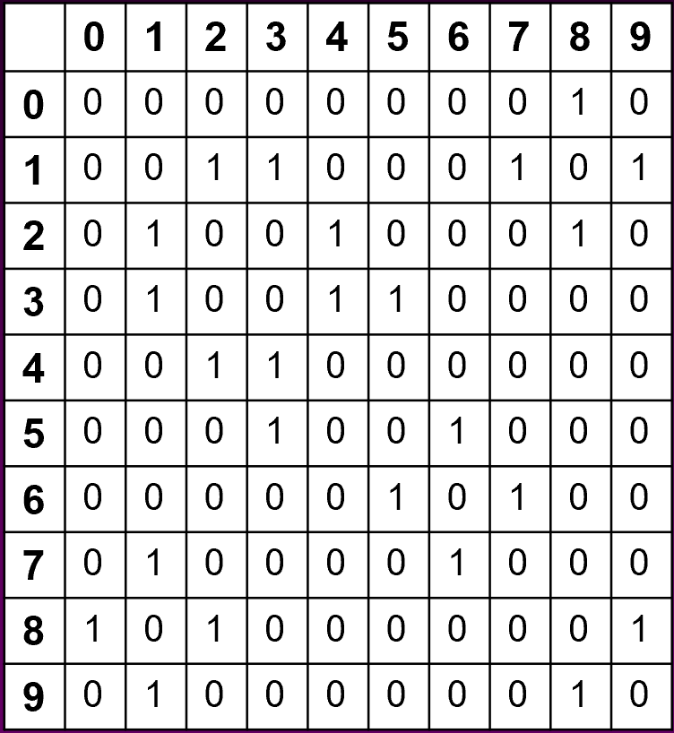
Adjacency Matrix Representation

Slide 31
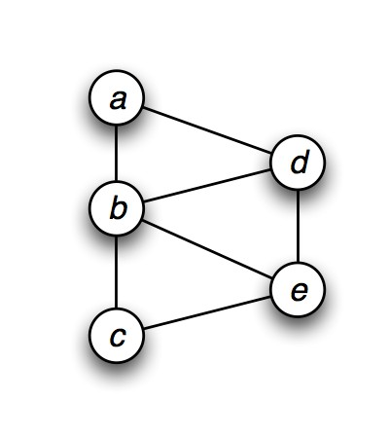
Adjacency Matrix Representation
Example (Undirected graph)
a b c d e
a 0 1 0 1 0
b 1 0 1 1 1
c 0 1 0 0 1
d 1 1 0 0 1
e 0 1 1 1 0
Graph representation Ch 22.1

Slide 32
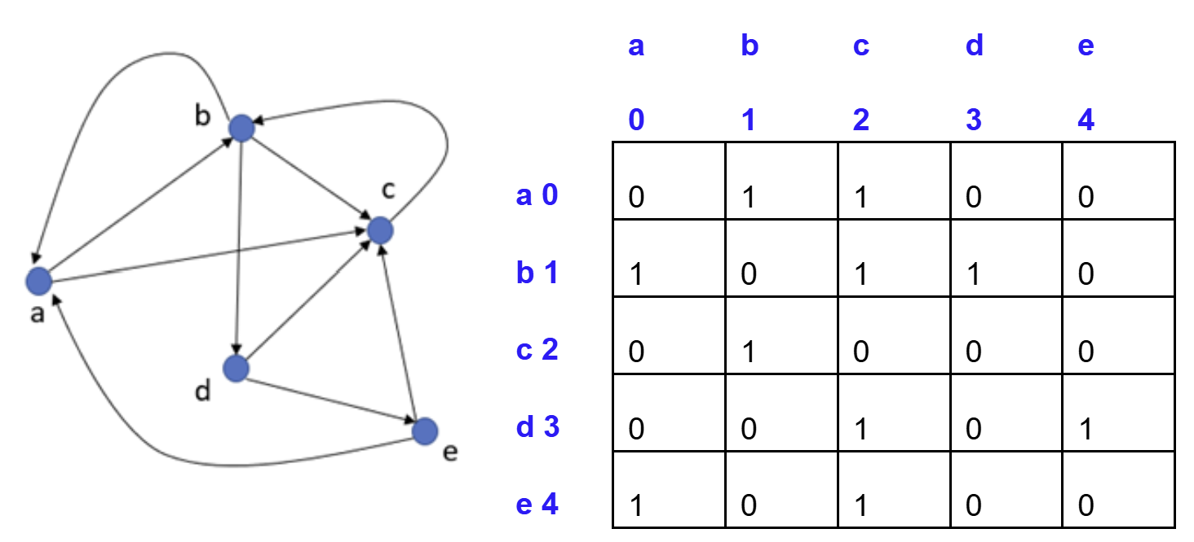
Adjacency Matrix Representation
Shows only the outgoing edges (REMEMBER!! NOT INCOMING)
Graph representation Ch 22.1

Slide 33
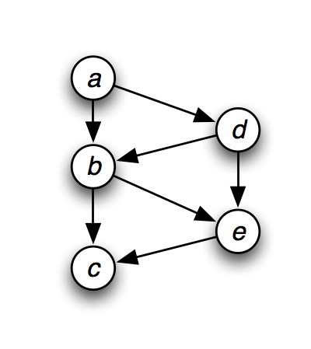
Adjacency Matrix Representation
Example (Directed graph)
a b c d e
a 0 1 0 1 0
b 0 0 1 0 1
c 0 0 0 0 0
d 0 1 0 0 1
e 0 0 1 0 0
Graph representation Ch 22.1

Slide 34
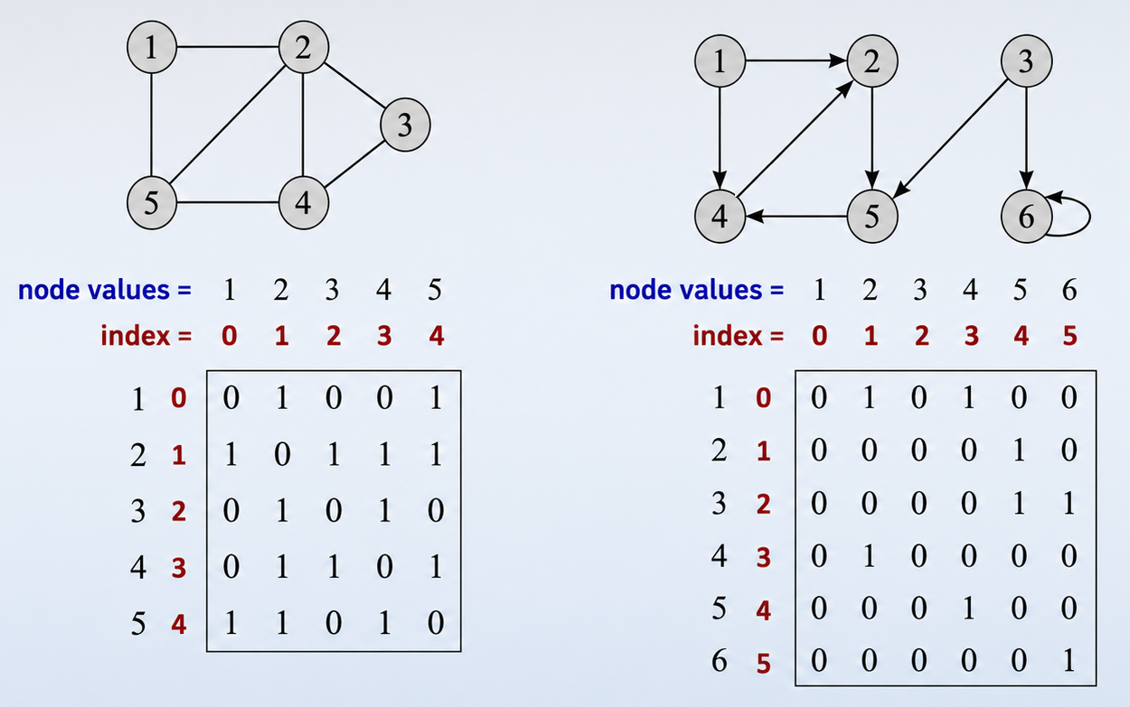
Adjacency matrix for directed and undirected graph
Image sources:
¹Cormen, Leiserson, Rivest, Stein. Introduction to Algorithms, 3rd edition, MIT Press, 2009
Graph representation Ch 22.1

Slide 35
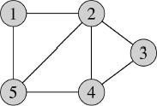
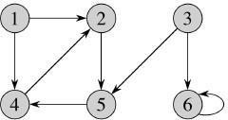
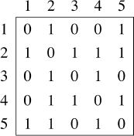
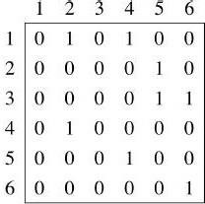
Adjacency matrix for directed and undirected graph
Image sources:
¹Cormen, Leiserson, Rivest, Stein. Introduction to Algorithms, 3rd edition, MIT Press, 2009
Graph representation Ch 22.1

Slide 36
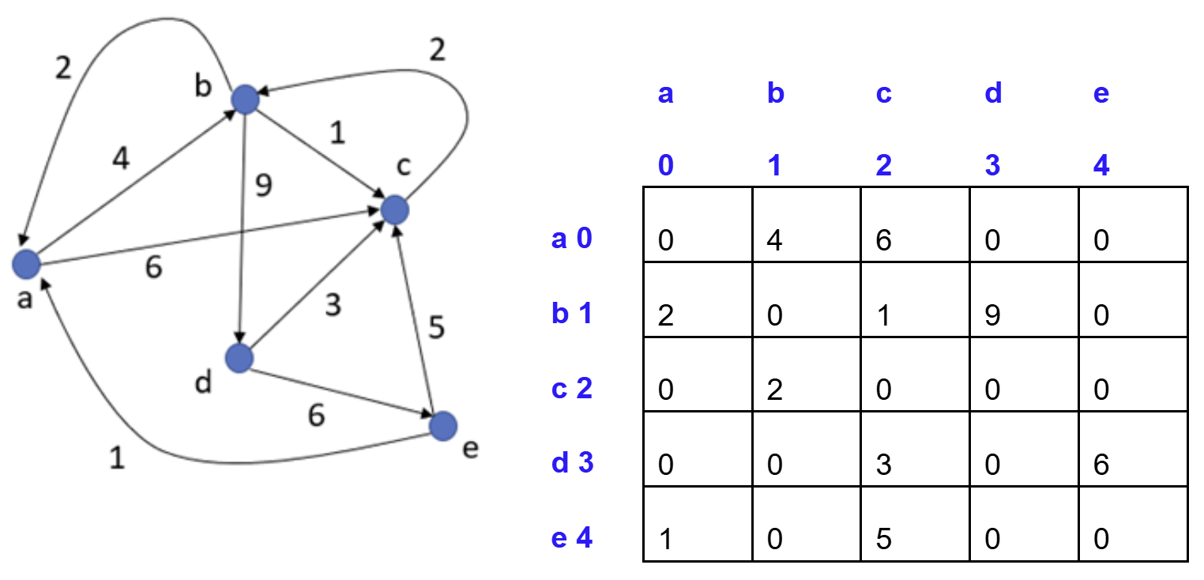
Weighted Directed Graph: Adjacency Matrix
Edge Weights: Represented by non-zero values in the matrix.
For an edge with weight w, write w in ONLY A[i][j] (Directed–have no symmetry)
Graph representation Ch 22.1

Slide 37
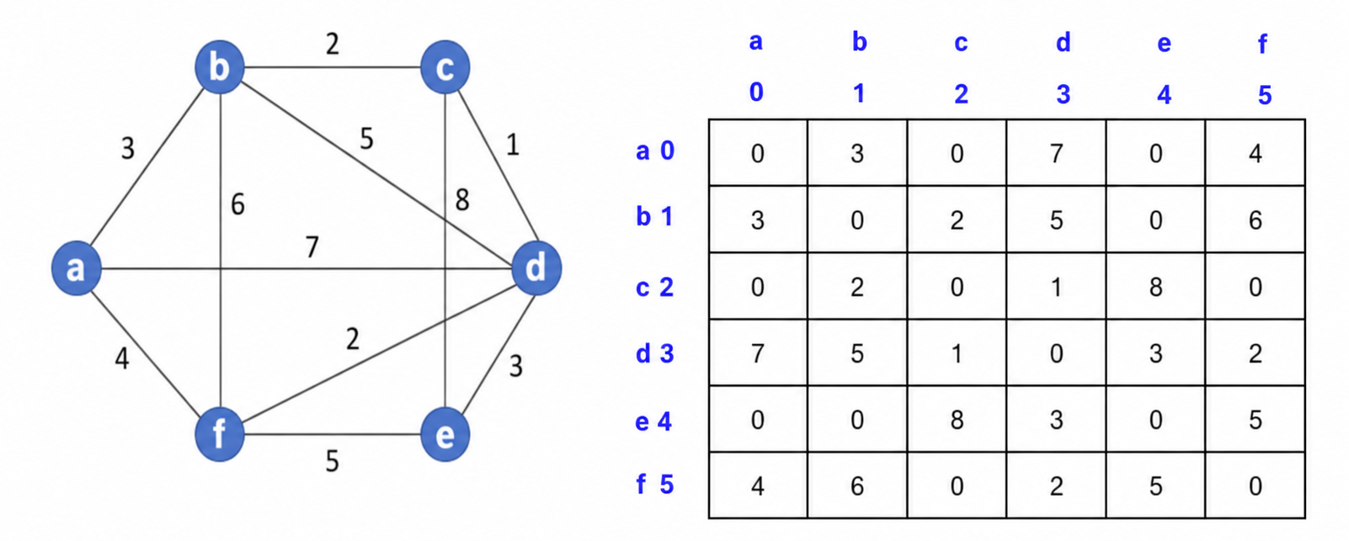
Weighted Undirected Graph: Adjacency Matrix
Edge Weights: Represented by non-zero values in the matrix.
For an edge with weight w, write w in A[i][j] and A[j][i] (Undirected–have symmetry)
Graph representation Ch 22.1

Slide 38
Adjacency matrix - Analysis
Adjacency matrix for N vertices takes N×N entries.
Space Complexity/Required: O(N^2) or O(V ²)
Time to list all vertices adjacent to u (all nodes which are connected to u): θ(V) or θ(N )
Comparison: Higher space cost than adjacency list.
Why Use Adjacency Matrix?
  Easier for certain computations. (Access time: O(1) )
  Trade-off: More space for faster operations.
Graph representation Ch 22.1

Slide 39
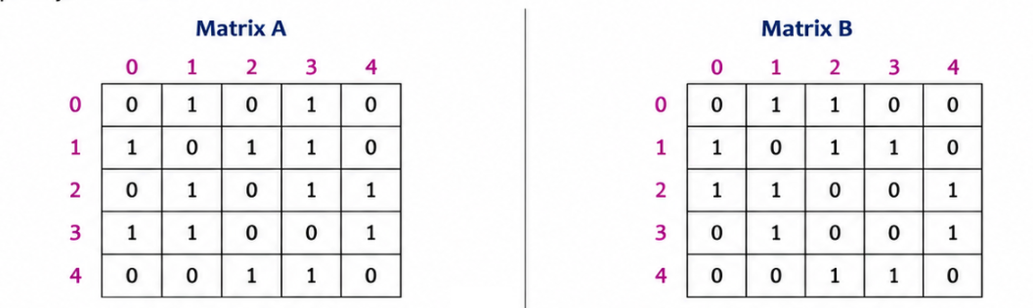
Practice Task: Directed or Undirected? (Homework)
Given the following adjacency matrices, determine whether each graph is Directed or Undirected. Give a reason for your answer.

Slide 40
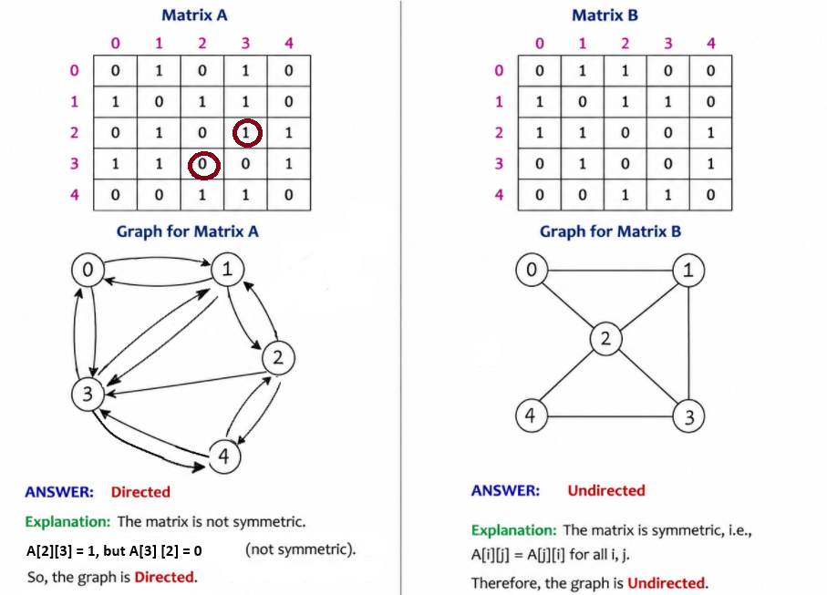
Practice Task: Directed or Undirected? (Homework)

Slide 41
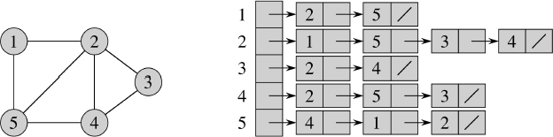
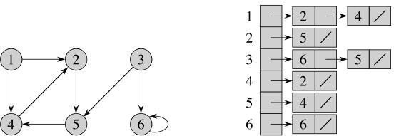
Adjacency List Representation
Vertices are represented by indices in an array.
Each entry in the array contains a linked list of adjacent vertices.
Represent the graph by listing for each vertex v_{i} its outgoing vertices in a list out(v_{i} ). (Representation can be linked list, or another appropriate structure.)
Image: Cormen, Leiserson, Rivest, Stein. Introduction to Algorithms, 3rd edition, MIT Press, 2009

Slide 42
Adjacency lists for undirected graph
Each edge occurs twice
Each vertex’s entry contains the indices of its adjacent vertices.
Class Edge { [Similar to LL’s Node class of Hashing]
int end point / destination
Edge next (next adjacent node in the LL chain)
}
Image:¹
¹Cormen, Leiserson, Rivest, Stein. Introduction to Algorithms, 3rd edition, MIT Press, 2009
Graph representation Ch 22.1

Slide 43
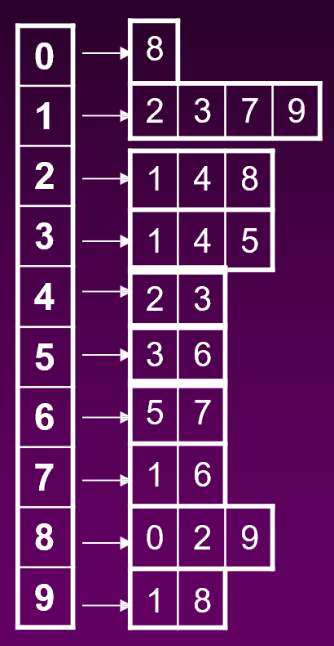
Adjacency lists for undirected graph
Each edge occurs twice
Each vertex’s entry contains the indices of its adjacent vertices.

Slide 44
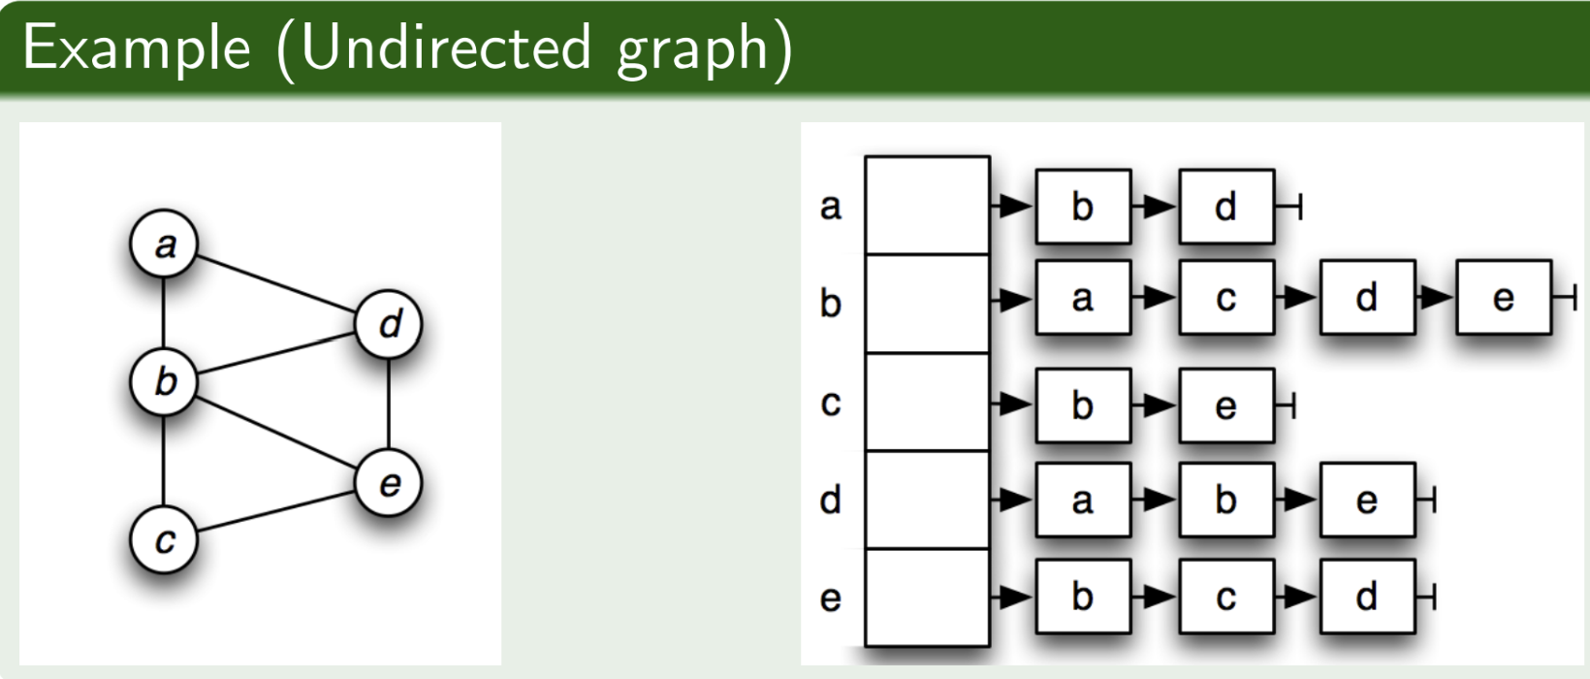
Adjacency lists for undirected graph
Each edge occurs twice
Each vertex’s entry contains the indices of its adjacent vertices.

Slide 45
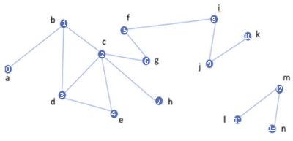
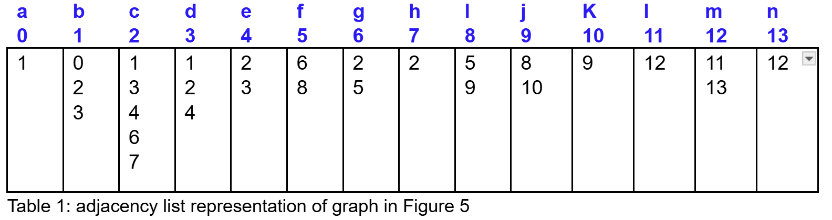
Adjacency lists for undirected graph
(Optional, Not conventional representation, used in central notes)

Slide 46
Adjacency lists for directed graph
Each edge occurs once
Edges are only listed for the source vertex (outgoing), not the destination.
Class Edge { [Similar to LL’s Node class of Hashing]
int end point / destination
Edge next (next adjacent node in the LL chain)
}
Image:
²Cormen, Leiserson, Rivest, Stein. Introduction to Algorithms, 3rd edition, MIT Press, 2009
Graph representation Ch 22.1

Slide 47
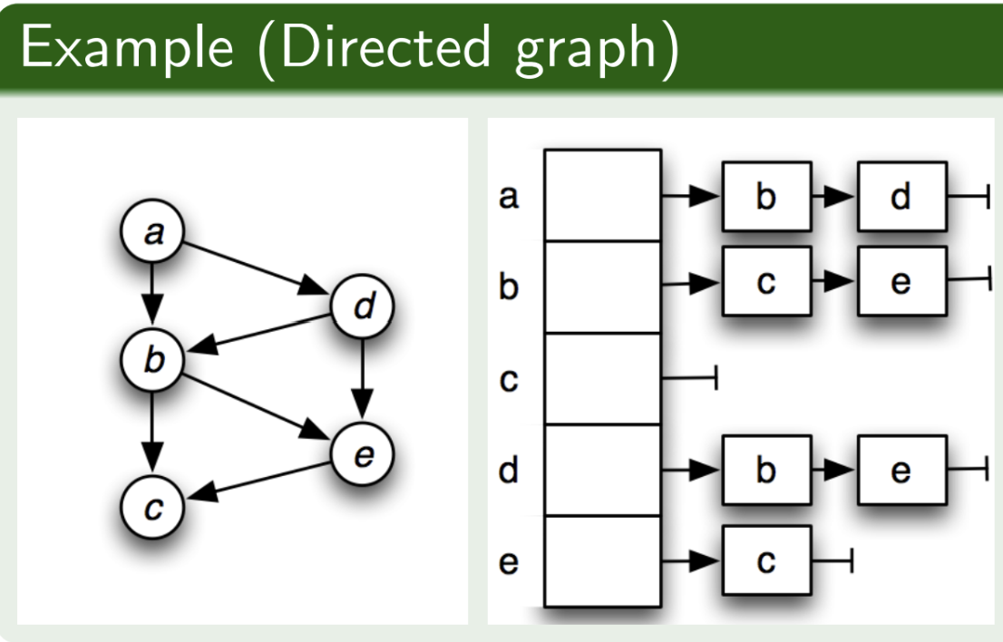
Adjacency lists for directed graph
Each edge occurs once
Edges are only listed for the source vertex (outgoing), not the destination.

Slide 48
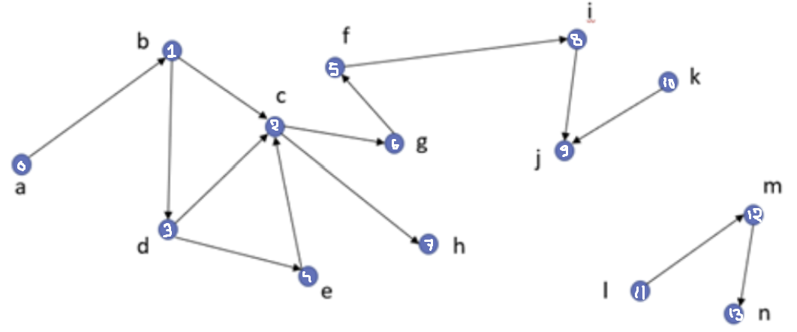
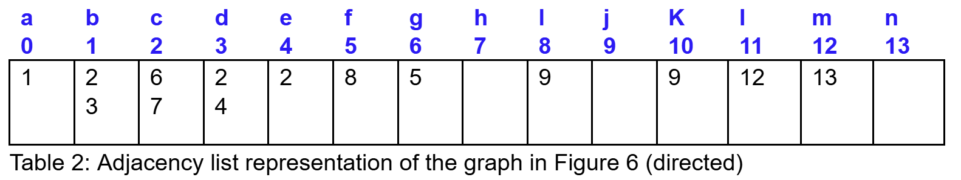
Adjacency lists for directed graph
(Optional,Not conventional representation, used in central notes)

Slide 49
Adjacency lists for Weighted Graphs
Often plain array may not be enough for Weighted Graphs:
In weighted graphs, both vertices and edges can have associated weights.
A simple array of lists is not sufficient to represent this.
Thus, in few cases, we need special edge class with weight
Class Edge { [Similar to LL’s Node class of Hashing]
int end point / destination
int weight
Edge next (next adjacent node in the LL chain)
}
Edge Class:
ep1 stores the index of the vertex connected by the edge.
weight stores the weight of the edge.

Slide 50
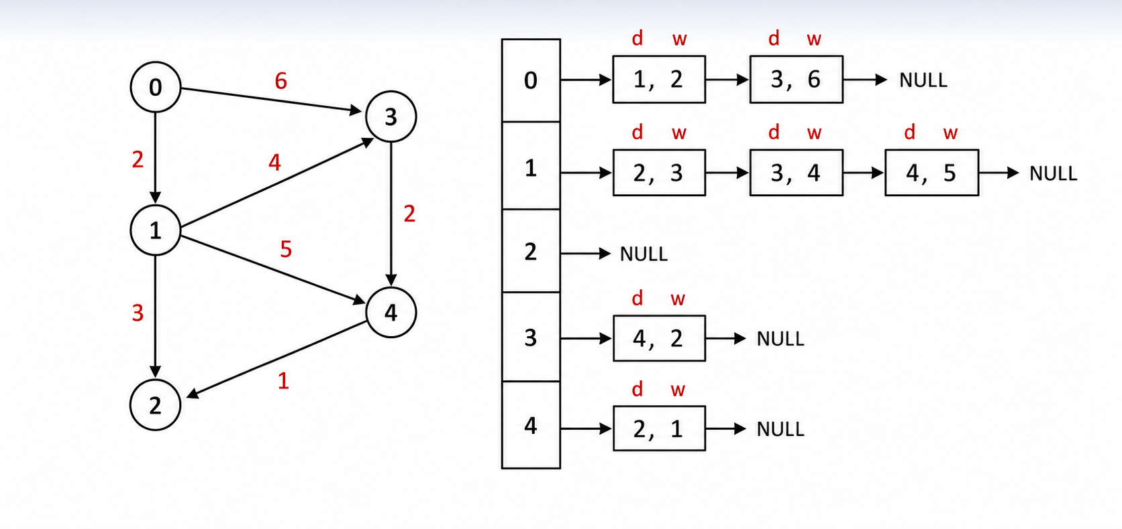
Adjacency lists for directed graph with edge weight

Slide 51
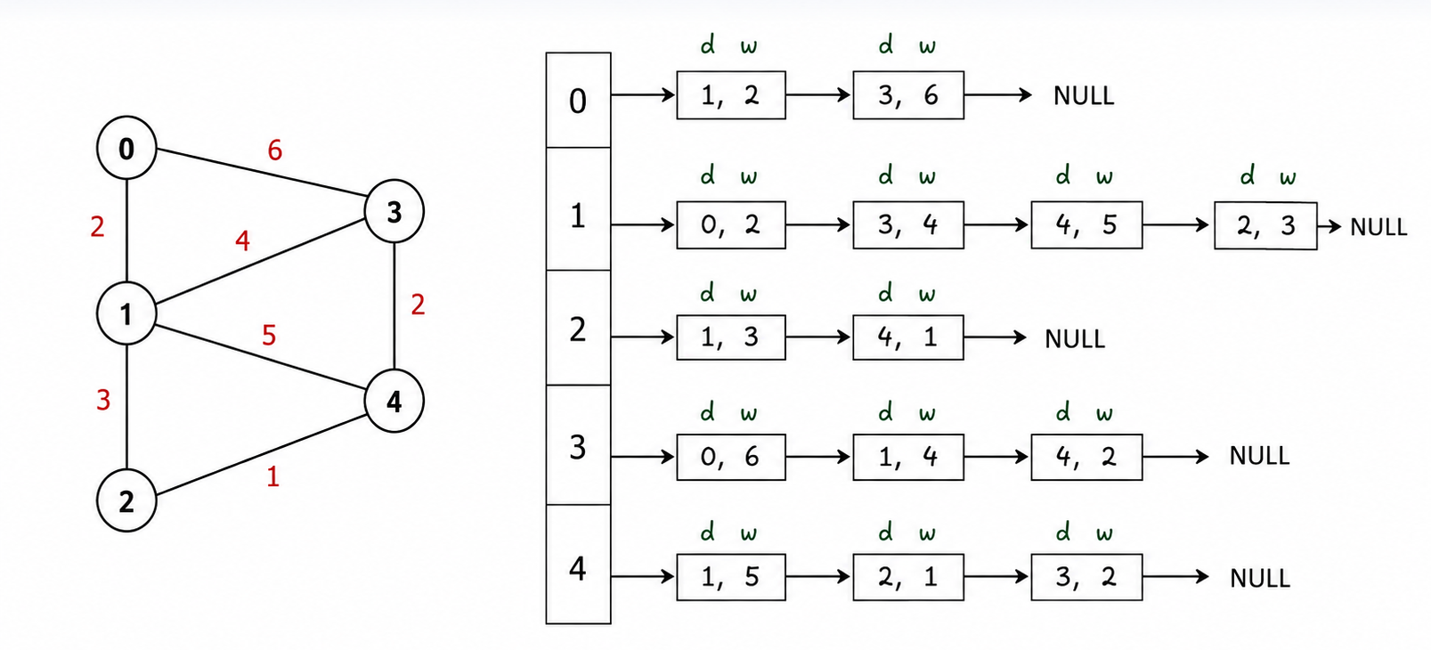
Adjacency lists for undirected graph with edge weight

Slide 52
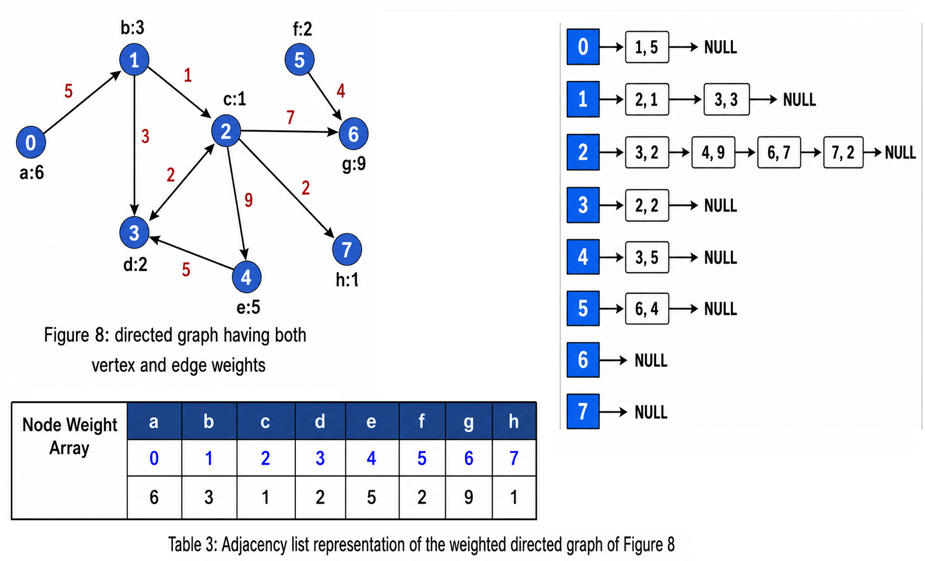
Adjacency lists for directed graph with edge and vertex weight

Slide 53
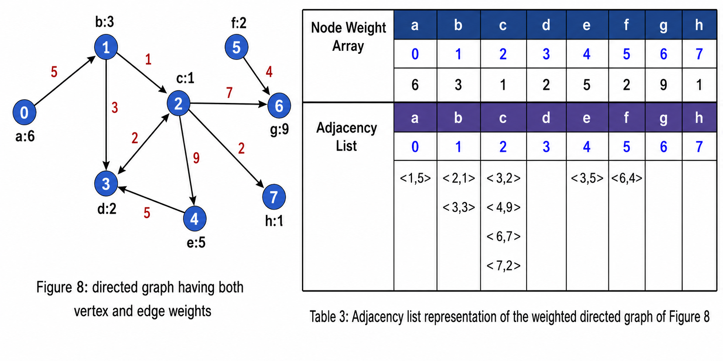
Adjacency lists for directed graph with edge and vertex weight
(Optional,Not conventional representation, used in central notes)
The tuple <x,y> stands for
<ep1 (destination), weight> of an edge

Slide 54

Practice Task: Directed or Undirected? (Homework)
Given the following adjacency lists, determine whether each graph is Directed or Undirected. Give a reason for your answer.

Slide 55
Practice Task: Directed or Undirected? (Homework)

Slide 56
Self-loop in A Graph
A self-loop in a graph is an edge that starts and ends at the same vertex.
It is an edge of the form (v, v).
ADJACENCY MATRIX
A
B
C
D
In the adjacency matrix, a self-loop at A is represented by setting the entry (A, A) to 1.
A
B
A
1
1
1
1
B
1
0
0
1
Self-loop
at A
C
1
0
0
1
D
1
1
1
0
C
D
ADJACENCY LIST
A
→
{ A, B, C, D }
In the adjacency list,
a self-loop at A is represented by including A in its own list.
Edges: (A,A), (A,B), (A,C), (A,D), (B,D), (C,D)
B
→
{ A, D }
C
→
{ A, D }
D
→
{ A, B, C }

Slide 57
Vertex Degrees (Recap)
For undirected graph:
Degree (deg⁡(v)): Number of edges connected to v
Here, v is a node/vertex
Degree of d is 3.
Because d is connected to b, c, e by 3 edges
For directed graph:
In-degree (indeg(v)): Number of incoming edges to v (Number of edges ending at the vertex)
Out-degree (outdeg(v)): Number of outgoing edges from v (Number of edges originating from the vertex)
In-degree of vertex d is 1. (incoming from b)
Out-degree of vertex d is 2. (out-going to c, e)

Slide 58
Adjacency List - Analysis
Space required: θ(V + E ).
For a graph with N vertices and M edges, the space complexity is O(N + M).
In an undirected graph, the total number of entries across all adjacency lists is 2M /2E
  Since each edge is stored twice.
In a directed graph, the total number of entries is M /E
  Each edge is stored once.
For an undirected graph: Time to list all vertices adjacent to vertex u: Θ(degree(u))
For a directed graph: Time to list all vertices adjacent to vertex u: Θ(outdegree(u))
Graph representation Ch 22.1

Slide 59
Comparison of graph representations
Graph representation Ch 22.1

Slide 60

Comparison of undirected graph representations (Important!)
Operation | Adjacency matrix | Adjacency list
Is (u, v ) ∈ E ? [Is there any connection between u and v?] | Θ(1) | Θ(deg (u))
List edges outgoing from u | Θ(n) or Θ(V) | Θ(deg (u))
Memory | Θ(n²) or Θ(V²) | Θ(m + n) = Θ(V + E)
Graph representation Ch 22.1

Slide 61

Comparison of undirected graph representations (Important!)
Operation | Adjacency matrix | Adjacency list
Is (u, v ) ∈ E ? [Is there any connection between u and v?] | Θ(1) | Θ(outdeg (u))
List edges outgoing from u | Θ(n) or Θ(V) | Θ(outdeg (u))
Memory | Θ(n²) or Θ(V²) | Θ(m + n) = Θ(V + E)

Slide 62
Sparse vs Dense Graph (Recap)
Sparse Graph: Few edges relative to the number of vertices (nodes). If |E|≈ |V|
Dense Graph: Many edges relative to the number of vertices (nodes). If |E|≈ |V|²
Importance:
The distinction between sparse and dense graphs influences the
choice of data structure for graph representation.
image source: https://www.researchgate.net/publication/333950431_Multi-moth_flame_optimization_for_solving_the_link_prediction_problem_in_complex_networks

Slide 63
Which representation to use? (Important!)
No general rule
Depends on use case
  How sparse is the graph?
  Which operations do we need to perform?
However, we usually follow the following rules:
Graph Type | Best Representation | Reason
Sparse Graph | Adjacency List | Memory efficient and fast traversal due to fewer edges.
Dense Graph | Adjacency Matrix | Efficient for edge lookups and handles high connectivity.
Graph representation Ch 22.1

Slide 64
Total graph representation types (8)
Adjacency matrix
Unweighted (show connections with 1)
  Undirected (u to v, v to u)
  Directed (u to v)
Weighted (show connections with edge weight)
  Undirected (u to v, v to u)
  Directed (u to v)
Adjacency List
Unweighted
  Undirected (u to v, v to u)
  Directed (u to v)
Weighted
  Undirected (u to v, v to u)
  Directed (u to v)

Slide 65
Incidence Matrix Representation (optional)
Use: Popularized by electrical circuit analysis.
Vertices & Edges Numbered:
Edges numbered from 0 to M−1. Here, M= no of edges
Vertices numbered from 0 to N−1. Here, N= no of vertices/nodes
Matrix Structure:
M×N (M rows for edges, N columns for vertices)

Slide 66

Incidence Matrix Representation: Undirected graph (optional)
Undirected Graph: 1s in columns of the two vertices connected by each edge.
Red writings are the numbering of the edges, not the weight

Slide 67

Incidence Matrix Representation: Directed Graph (optional)
Outgoing Edge: Put a 1 in the source vertex column.
Incoming Edge: Put a -1 in the destination vertex column.
Red writings are the numbering of the edges, not the weight
Edge-Weighted Graph: Use positive/negative weights instead of 1 and -1. (Not part of syllabus)

Slide 68
Incidence Matrix Representation (optional)
Space Complexity:
Space Complexity: O(MN) or O(VE) or O(VxE).
Sparse Graphs: Incidence matrix/ Adjacency list may be cheaper than adjacency matrix.
Dense Graphs: Adjacency matrix may be better.
Applications:
Popular in electrical circuit analysis (sparse graphs).
Specific algorithms require incidence matrix for computation efficiency.

Slide 69
The End

